Slide 1

Healthcare Analytics for Doctor Vists_TIRTC
Y.Nithya kalyani
Stu id:STU68494473c73061749632115

Slide 2

PROBLEM STATEMENT
Healthcare providers need to understand the factors that influence how frequently patients visit doctors. Analyzing patient information such as age, gender, income, illness, health status, chronic conditions, and healthcare access can help identify patterns in doctor visits.
This project aims to analyze healthcare data and identify the key factors associated with doctor-visit frequency, using data analysis and machine learning techniques to generate meaningful healthcare insights and predict patients who may require more frequent medical visits.

Slide 3
Project Description
Healthcare Analytics for Doctor Visits is a data analytics and machine learning project that analyzes patient healthcare data to understand patterns in doctor visits. The project examines factors such as age, gender, income, illness, health status, chronic conditions, and healthcare access. Using Python, Pandas, NumPy, Matplotlib, Seaborn, and Scikit-learn, the data is cleaned, explored, and visualized to identify important healthcare trends. A Random Forest machine learning model is also used to predict patients who may have frequent doctor visits based on their healthcare and demographic characteristics.

Slide 4

WHO ARE THE END USERS?
Doctors and Healthcare Professionals – to understand patient visit patterns and identify patients who may require frequent medical attention.
Hospitals and Clinics – to analyze healthcare utilization and improve resource planning.
Healthcare Administrators – to support data-driven decisions regarding staffing and healthcare services.
Healthcare Analysts and Researchers – to study factors influencing doctor visits and identify healthcare trends.
Patients – indirectly, through improved healthcare planning and service availability.

Slide 5

Technology Used
Python
Google Colab
Pandas
NumPy
Matplotlib
Seaborn
Scikit-learn

Slide 6
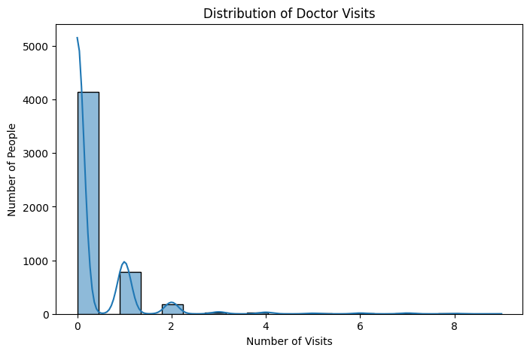
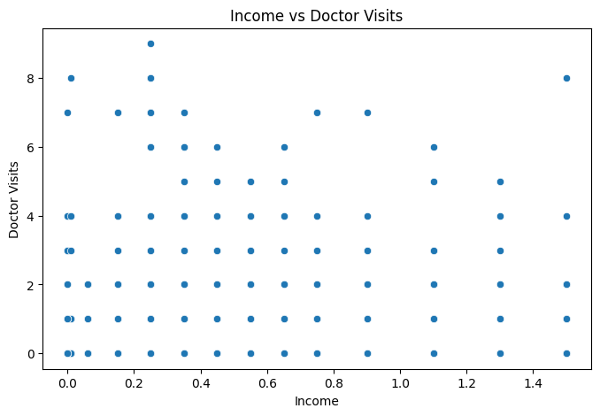
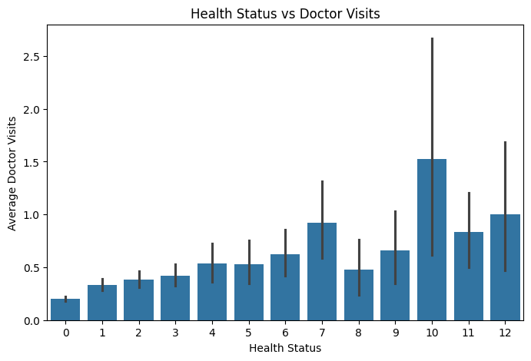
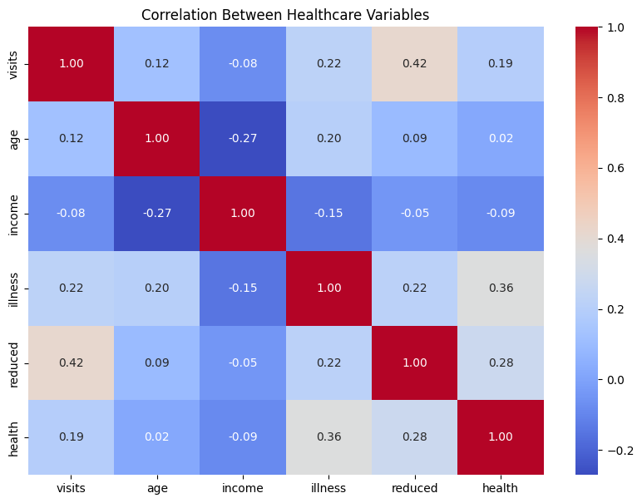
RESULTS
Demo Link

Slide 7
Thank you
.
.

